Slide 1

Welcome to:
Open Forum Meeting
6 PM Wednesday, January 24, 2017
Broun Hall, Room 235

Slide 2
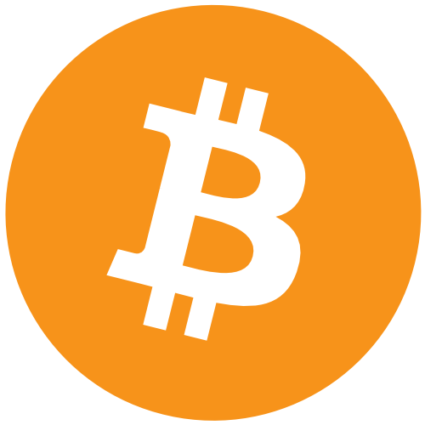


Open Forum Topic: Block Chain
Notes:
Poll room for who’s heard of currency and what they have heard about it
I don’t claim to be an expert, I’ve just read a lot about it (Give credibility)

Slide 3

Let me dispel the rumors..
Notes:
BITCOIN AND BLOCKCHAIN ARE NOT THE SAME THING
Blockchain technology is not solely a currency

Slide 4

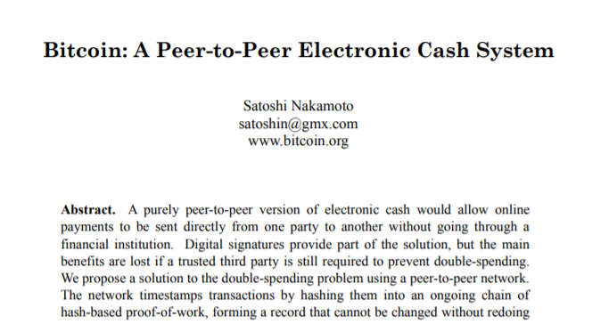
The history behind blockchain

Slide 5
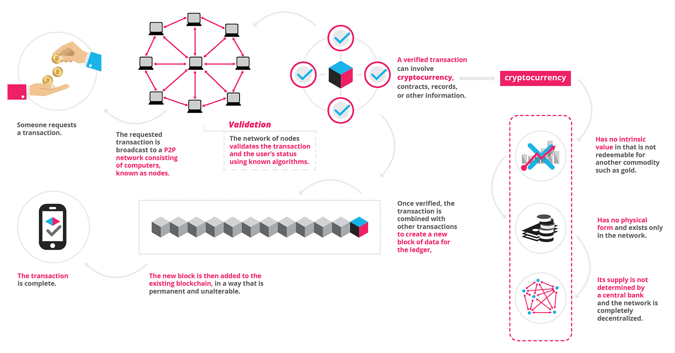
What is Block Chain?
https://blockgeeks.com/guides/what-is-blockchain-technology/
Notes:
Explain infographic
Blockchain is more or less a theory- implemented as a technology

Slide 6
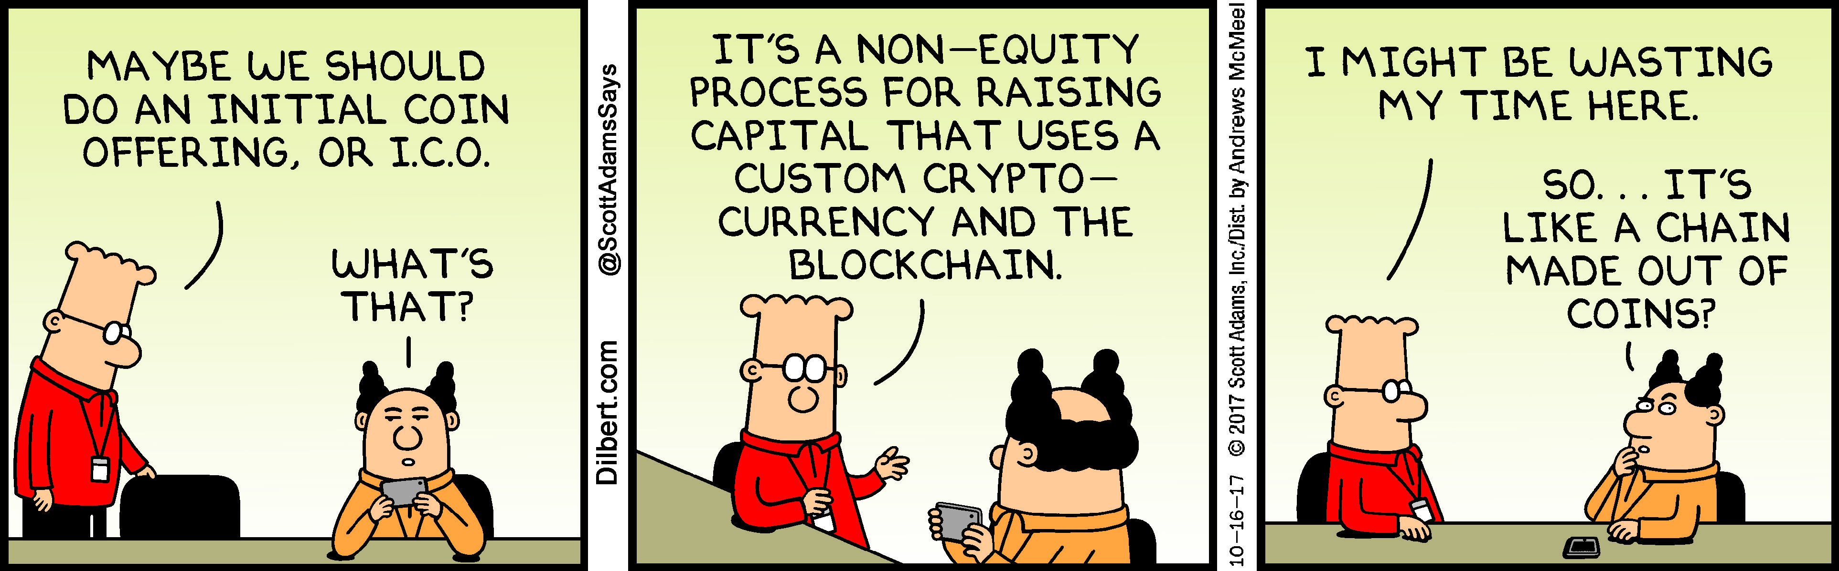
Why use blockchain?
Almost entirely decentralized
Most likely security breach is human error
Highly secure
More “power to the people”
Extended abilities as a decentralized computer

Slide 7
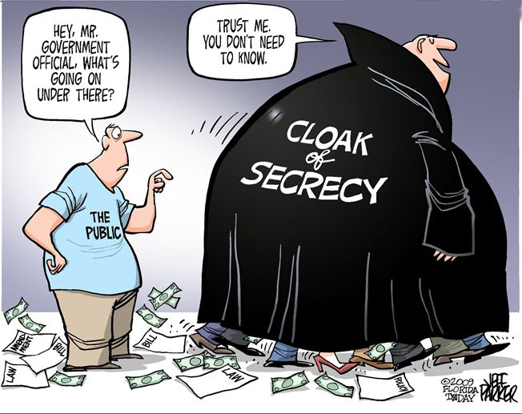
Decentralization (Pros)
No one sets the rules except for what is agreed upon by the network (Forks)
Very difficult to hack
Everything is transparent
Anonymity
Supply
Not determined by government or singular entity

Slide 8
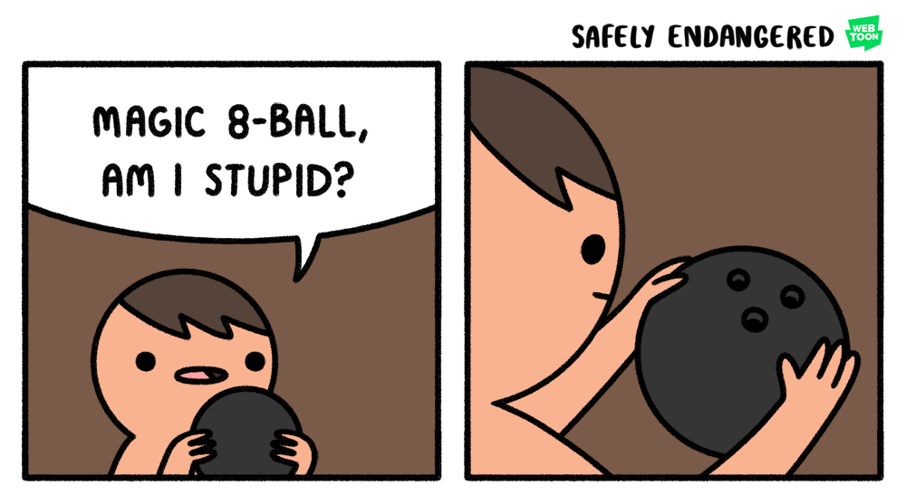
Decentralization (Cons)
Is completely dependent upon it’s users (May not exist in the far future)
Government intervention
Much of the security is dependent on the individual

Slide 9
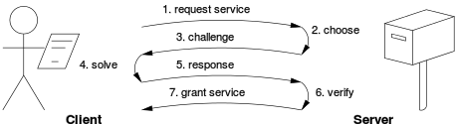
Validation (Proof of work)
Every block is a set of transactions during a certain period of time
Expensive computer calculations called “mining” validates each block in exchange for newly created currency
Cryptocurrency is not the first place POW is used

Slide 10
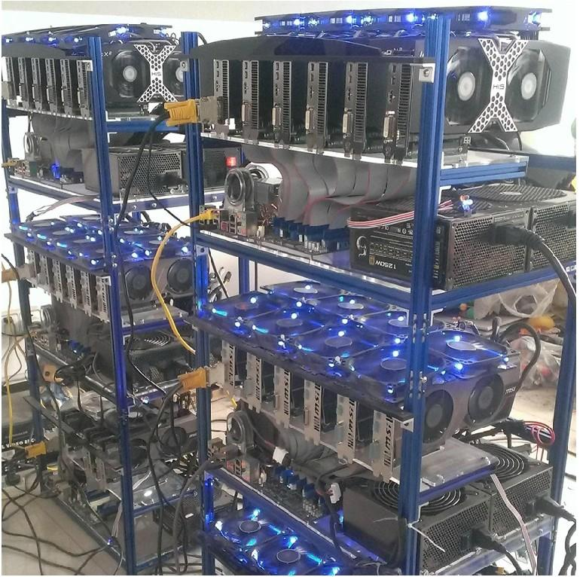
How do I mine?
Any computational component technically has the ability to mine
Power efficiency is an important variable
Different currencies require different equipment

Slide 11
(PoW) Pros and cons
In 2015, statistics say 1.5 American households could have been powered in one day with the power it took to mine one Bitcoin. (https://blockgeeks.com/bitcoins-energy-consumption/)
Very secure- as an attack would require more resources than would likely be gained
Is difficult to scale, average block time of Bitcoin is now 10 minutes
Vulnerable to a 51% attack

Slide 12
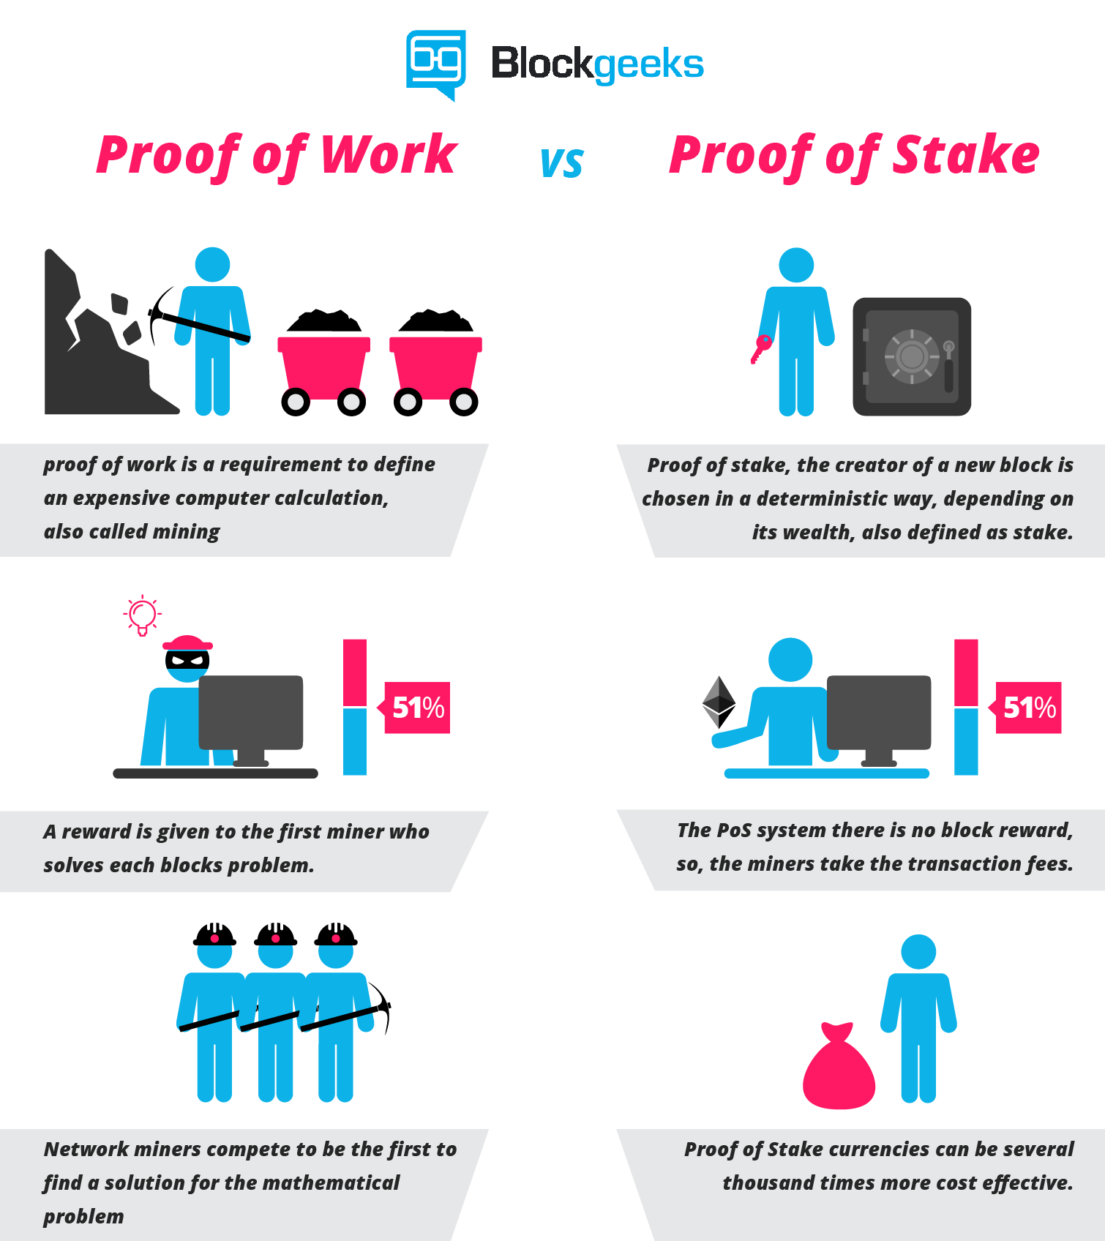
Validation (Proof of stake)
Instead of requiring tons of guessing and large amounts of computational power, the new “forger” could be chosen by the network
This forger is chosen at random based on how much stake they have in the network
If any validator is found to have an invalid block, their “stake” is removed

Slide 13
(POS) Pros and cons
The initial code must be bulletproof- since it will be the weakest point in the system
Massive energy savings- you would only need a running laptop to participate as a validator
More individuals would be encouraged to hold the currency, as staking it increases their take
Removes the insecurity issue of 51%

Slide 14
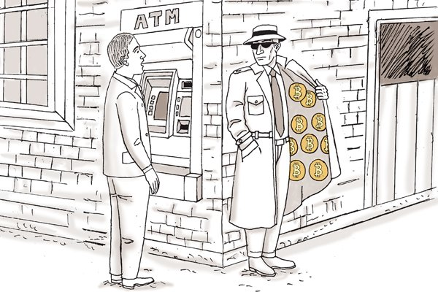
Bitcoin
Widely known as the first “cryptocurrency” built on the blockchain and, at times, is considered synonymous
Meant to be just that- a currency and not much more
Changes to the currency are very difficult (e.g Bitcoin Cash)

Slide 15
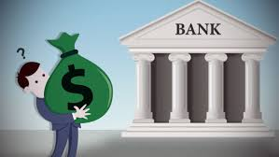
Ripple
Growing in popularity
Very fast transaction times
Primary purpose is to save transaction time and costs between banks
Great for international transfers

Slide 16
Ethereum
My personal favorite – probably the most popular currency with the most utility
A Turing Complete programming language
Every address has the ability to run code on it – or smart contracts

Slide 17
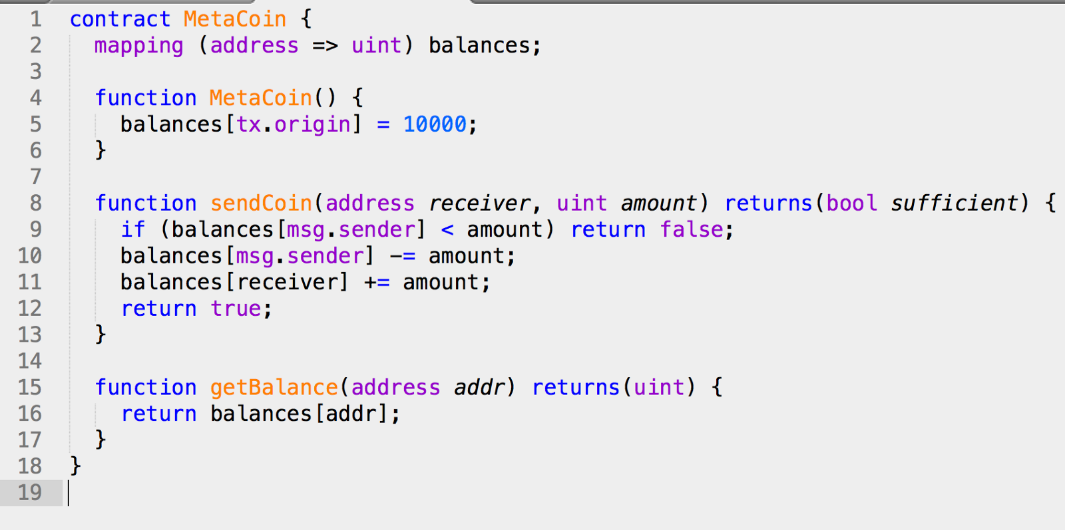
Ethereum and it’s advances
ÐApps (https://www.stateofthedapps.com/)
Smart Contracts
A dedicated team to work on the network (Could be considered centralized)
Casper (Proof of Stake)
Swarm
Sharding/Plasma

Slide 18
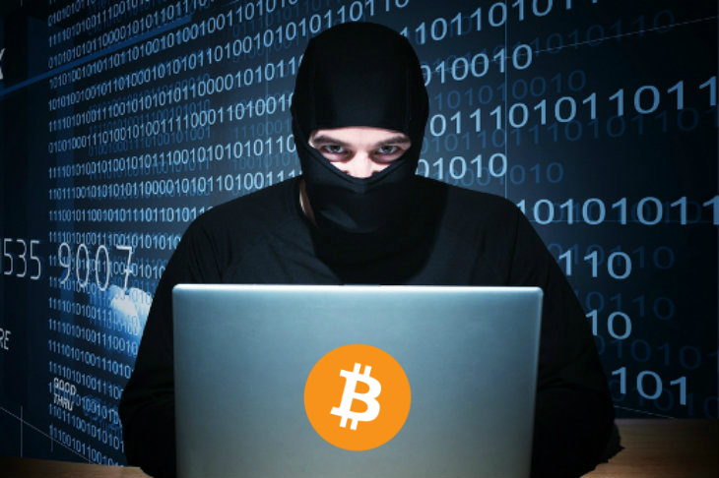
Issues facing blockchain today
Illegal use
Scalability
Mass adoption
Privacy

Slide 19
So why does it matter?
The potential is astronomical, assuming key issues are resolved.
Can culturally and economically change the world financial system
Has helped to stabilize some third-world country economies (somewhat)
Could potentially eliminate the need for locally hosted servers and massive, insecure, controlled databases

Slide 20

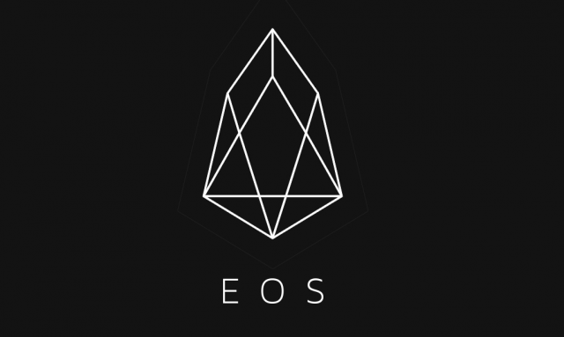

What can you do with this?
Web 3.0- programs can be run on the blockchain
Create a node- participate in the network through mining
Create products using the blockchain (https://etherscan.io/tokens) e.g GOLEM

